Slide 1
Sieve of Eratosthenes

Slide 2
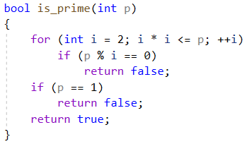
Sieve of Eratosthenes
Need to find all primes from 1 to n.
Prime numbers is a numbers that have 2 distinct divisors, 1 and themselves.
Let’s take a look, how we can check number primeness:
If there is no divisor from 2 to square root of our number, then our number is prime:

Slide 3

Sieve of Eratosthenes
Need to find all primes from 1 to n.
Each number we can check in O($\sqrt{n})$ time.
For checking all numbers from 1 to n we will need $O(n\sqrt{n})$ time.
We can compute faster.

Slide 4
Sieve of Eratosthenes
Let’s create a table with all numbers from 1 to 100 (n = 100, for example):
1 | 2 | 3 | 4 | 5 | 6 | 7 | 8 | 9 | 10
11 | 12 | 13 | 14 | 15 | 16 | 17 | 18 | 19 | 20
21 | 22 | 23 | 24 | 25 | 26 | 27 | 28 | 29 | 30
31 | 32 | 33 | 34 | 35 | 36 | 37 | 38 | 39 | 40
41 | 42 | 43 | 44 | 45 | 46 | 47 | 48 | 49 | 50
51 | 52 | 53 | 54 | 55 | 56 | 57 | 58 | 59 | 60
61 | 62 | 63 | 64 | 65 | 66 | 67 | 68 | 69 | 70
71 | 72 | 73 | 74 | 75 | 76 | 77 | 78 | 79 | 80
81 | 82 | 83 | 84 | 85 | 86 | 87 | 88 | 89 | 90
91 | 92 | 93 | 94 | 95 | 96 | 97 | 98 | 99 | 100

Slide 5
Sieve of Eratosthenes
Let’s start from 2:
1 | 2 | 3 | 4 | 5 | 6 | 7 | 8 | 9 | 10
11 | 12 | 13 | 14 | 15 | 16 | 17 | 18 | 19 | 20
21 | 22 | 23 | 24 | 25 | 26 | 27 | 28 | 29 | 30
31 | 32 | 33 | 34 | 35 | 36 | 37 | 38 | 39 | 40
41 | 42 | 43 | 44 | 45 | 46 | 47 | 48 | 49 | 50
51 | 52 | 53 | 54 | 55 | 56 | 57 | 58 | 59 | 60
61 | 62 | 63 | 64 | 65 | 66 | 67 | 68 | 69 | 70
71 | 72 | 73 | 74 | 75 | 76 | 77 | 78 | 79 | 80
81 | 82 | 83 | 84 | 85 | 86 | 87 | 88 | 89 | 90
91 | 92 | 93 | 94 | 95 | 96 | 97 | 98 | 99 | 100

Slide 6
Sieve of Eratosthenes
Let’s start from 2:
1 | 2 | 3 | 4 | 5 | 6 | 7 | 8 | 9 | 10
11 | 12 | 13 | 14 | 15 | 16 | 17 | 18 | 19 | 20
21 | 22 | 23 | 24 | 25 | 26 | 27 | 28 | 29 | 30
31 | 32 | 33 | 34 | 35 | 36 | 37 | 38 | 39 | 40
41 | 42 | 43 | 44 | 45 | 46 | 47 | 48 | 49 | 50
51 | 52 | 53 | 54 | 55 | 56 | 57 | 58 | 59 | 60
61 | 62 | 63 | 64 | 65 | 66 | 67 | 68 | 69 | 70
71 | 72 | 73 | 74 | 75 | 76 | 77 | 78 | 79 | 80
81 | 82 | 83 | 84 | 85 | 86 | 87 | 88 | 89 | 90
91 | 92 | 93 | 94 | 95 | 96 | 97 | 98 | 99 | 100

Slide 7
Sieve of Eratosthenes
And mark all number that are dividing by 2 without remainder:
1 | 2 | 3 | 4 | 5 | 6 | 7 | 8 | 9 | 10
11 | 12 | 13 | 14 | 15 | 16 | 17 | 18 | 19 | 20
21 | 22 | 23 | 24 | 25 | 26 | 27 | 28 | 29 | 30
31 | 32 | 33 | 34 | 35 | 36 | 37 | 38 | 39 | 40
41 | 42 | 43 | 44 | 45 | 46 | 47 | 48 | 49 | 50
51 | 52 | 53 | 54 | 55 | 56 | 57 | 58 | 59 | 60
61 | 62 | 63 | 64 | 65 | 66 | 67 | 68 | 69 | 70
71 | 72 | 73 | 74 | 75 | 76 | 77 | 78 | 79 | 80
81 | 82 | 83 | 84 | 85 | 86 | 87 | 88 | 89 | 90
91 | 92 | 93 | 94 | 95 | 96 | 97 | 98 | 99 | 100

Slide 8
Sieve of Eratosthenes
And mark all numbers that dividing by 2:
1 | 2 | 3 | 4 | 5 | 6 | 7 | 8 | 9 | 10
11 | 12 | 13 | 14 | 15 | 16 | 17 | 18 | 19 | 20
21 | 22 | 23 | 24 | 25 | 26 | 27 | 28 | 29 | 30
31 | 32 | 33 | 34 | 35 | 36 | 37 | 38 | 39 | 40
41 | 42 | 43 | 44 | 45 | 46 | 47 | 48 | 49 | 50
51 | 52 | 53 | 54 | 55 | 56 | 57 | 58 | 59 | 60
61 | 62 | 63 | 64 | 65 | 66 | 67 | 68 | 69 | 70
71 | 72 | 73 | 74 | 75 | 76 | 77 | 78 | 79 | 80
81 | 82 | 83 | 84 | 85 | 86 | 87 | 88 | 89 | 90
91 | 92 | 93 | 94 | 95 | 96 | 97 | 98 | 99 | 100

Slide 9
Sieve of Eratosthenes
Let’s find first unmarked number, and repeat the same for it. In our case it’s 3.
1 | 2 | 3 | 4 | 5 | 6 | 7 | 8 | 9 | 10
11 | 12 | 13 | 14 | 15 | 16 | 17 | 18 | 19 | 20
21 | 22 | 23 | 24 | 25 | 26 | 27 | 28 | 29 | 30
31 | 32 | 33 | 34 | 35 | 36 | 37 | 38 | 39 | 40
41 | 42 | 43 | 44 | 45 | 46 | 47 | 48 | 49 | 50
51 | 52 | 53 | 54 | 55 | 56 | 57 | 58 | 59 | 60
61 | 62 | 63 | 64 | 65 | 66 | 67 | 68 | 69 | 70
71 | 72 | 73 | 74 | 75 | 76 | 77 | 78 | 79 | 80
81 | 82 | 83 | 84 | 85 | 86 | 87 | 88 | 89 | 90
91 | 92 | 93 | 94 | 95 | 96 | 97 | 98 | 99 | 100

Slide 10
Sieve of Eratosthenes
Let’s find first unmarked number, and repeat the same for it. In our case it’s 3.
1 | 2 | 3 | 4 | 5 | 6 | 7 | 8 | 9 | 10
11 | 12 | 13 | 14 | 15 | 16 | 17 | 18 | 19 | 20
21 | 22 | 23 | 24 | 25 | 26 | 27 | 28 | 29 | 30
31 | 32 | 33 | 34 | 35 | 36 | 37 | 38 | 39 | 40
41 | 42 | 43 | 44 | 45 | 46 | 47 | 48 | 49 | 50
51 | 52 | 53 | 54 | 55 | 56 | 57 | 58 | 59 | 60
61 | 62 | 63 | 64 | 65 | 66 | 67 | 68 | 69 | 70
71 | 72 | 73 | 74 | 75 | 76 | 77 | 78 | 79 | 80
81 | 82 | 83 | 84 | 85 | 86 | 87 | 88 | 89 | 90
91 | 92 | 93 | 94 | 95 | 96 | 97 | 98 | 99 | 100

Slide 11
Sieve of Eratosthenes
And again for 5:
1 | 2 | 3 | 4 | 5 | 6 | 7 | 8 | 9 | 10
11 | 12 | 13 | 14 | 15 | 16 | 17 | 18 | 19 | 20
21 | 22 | 23 | 24 | 25 | 26 | 27 | 28 | 29 | 30
31 | 32 | 33 | 34 | 35 | 36 | 37 | 38 | 39 | 40
41 | 42 | 43 | 44 | 45 | 46 | 47 | 48 | 49 | 50
51 | 52 | 53 | 54 | 55 | 56 | 57 | 58 | 59 | 60
61 | 62 | 63 | 64 | 65 | 66 | 67 | 68 | 69 | 70
71 | 72 | 73 | 74 | 75 | 76 | 77 | 78 | 79 | 80
81 | 82 | 83 | 84 | 85 | 86 | 87 | 88 | 89 | 90
91 | 92 | 93 | 94 | 95 | 96 | 97 | 98 | 99 | 100

Slide 12
Sieve of Eratosthenes
And again for 5:
1 | 2 | 3 | 4 | 5 | 6 | 7 | 8 | 9 | 10
11 | 12 | 13 | 14 | 15 | 16 | 17 | 18 | 19 | 20
21 | 22 | 23 | 24 | 25 | 26 | 27 | 28 | 29 | 30
31 | 32 | 33 | 34 | 35 | 36 | 37 | 38 | 39 | 40
41 | 42 | 43 | 44 | 45 | 46 | 47 | 48 | 49 | 50
51 | 52 | 53 | 54 | 55 | 56 | 57 | 58 | 59 | 60
61 | 62 | 63 | 64 | 65 | 66 | 67 | 68 | 69 | 70
71 | 72 | 73 | 74 | 75 | 76 | 77 | 78 | 79 | 80
81 | 82 | 83 | 84 | 85 | 86 | 87 | 88 | 89 | 90
91 | 92 | 93 | 94 | 95 | 96 | 97 | 98 | 99 | 100

Slide 13
Sieve of Eratosthenes
And again for 7:
1 | 2 | 3 | 4 | 5 | 6 | 7 | 8 | 9 | 10
11 | 12 | 13 | 14 | 15 | 16 | 17 | 18 | 19 | 20
21 | 22 | 23 | 24 | 25 | 26 | 27 | 28 | 29 | 30
31 | 32 | 33 | 34 | 35 | 36 | 37 | 38 | 39 | 40
41 | 42 | 43 | 44 | 45 | 46 | 47 | 48 | 49 | 50
51 | 52 | 53 | 54 | 55 | 56 | 57 | 58 | 59 | 60
61 | 62 | 63 | 64 | 65 | 66 | 67 | 68 | 69 | 70
71 | 72 | 73 | 74 | 75 | 76 | 77 | 78 | 79 | 80
81 | 82 | 83 | 84 | 85 | 86 | 87 | 88 | 89 | 90
91 | 92 | 93 | 94 | 95 | 96 | 97 | 98 | 99 | 100

Slide 14
Sieve of Eratosthenes
And again for 7:
1 | 2 | 3 | 4 | 5 | 6 | 7 | 8 | 9 | 10
11 | 12 | 13 | 14 | 15 | 16 | 17 | 18 | 19 | 20
21 | 22 | 23 | 24 | 25 | 26 | 27 | 28 | 29 | 30
31 | 32 | 33 | 34 | 35 | 36 | 37 | 38 | 39 | 40
41 | 42 | 43 | 44 | 45 | 46 | 47 | 48 | 49 | 50
51 | 52 | 53 | 54 | 55 | 56 | 57 | 58 | 59 | 60
61 | 62 | 63 | 64 | 65 | 66 | 67 | 68 | 69 | 70
71 | 72 | 73 | 74 | 75 | 76 | 77 | 78 | 79 | 80
81 | 82 | 83 | 84 | 85 | 86 | 87 | 88 | 89 | 90
91 | 92 | 93 | 94 | 95 | 96 | 97 | 98 | 99 | 100

Slide 15
Sieve of Eratosthenes
How we can see, all remained numbers are primes:
1 | 2 | 3 | 4 | 5 | 6 | 7 | 8 | 9 | 10
11 | 12 | 13 | 14 | 15 | 16 | 17 | 18 | 19 | 20
21 | 22 | 23 | 24 | 25 | 26 | 27 | 28 | 29 | 30
31 | 32 | 33 | 34 | 35 | 36 | 37 | 38 | 39 | 40
41 | 42 | 43 | 44 | 45 | 46 | 47 | 48 | 49 | 50
51 | 52 | 53 | 54 | 55 | 56 | 57 | 58 | 59 | 60
61 | 62 | 63 | 64 | 65 | 66 | 67 | 68 | 69 | 70
71 | 72 | 73 | 74 | 75 | 76 | 77 | 78 | 79 | 80
81 | 82 | 83 | 84 | 85 | 86 | 87 | 88 | 89 | 90
91 | 92 | 93 | 94 | 95 | 96 | 97 | 98 | 99 | 100

Slide 16
Sieve of Eratosthenes
How we can see, all remained numbers are primes:
1 | 2 | 3 | 4 | 5 | 6 | 7 | 8 | 9 | 10
11 | 12 | 13 | 14 | 15 | 16 | 17 | 18 | 19 | 20
21 | 22 | 23 | 24 | 25 | 26 | 27 | 28 | 29 | 30
31 | 32 | 33 | 34 | 35 | 36 | 37 | 38 | 39 | 40
41 | 42 | 43 | 44 | 45 | 46 | 47 | 48 | 49 | 50
51 | 52 | 53 | 54 | 55 | 56 | 57 | 58 | 59 | 60
61 | 62 | 63 | 64 | 65 | 66 | 67 | 68 | 69 | 70
71 | 72 | 73 | 74 | 75 | 76 | 77 | 78 | 79 | 80
81 | 82 | 83 | 84 | 85 | 86 | 87 | 88 | 89 | 90
91 | 92 | 93 | 94 | 95 | 96 | 97 | 98 | 99 | 100

Slide 17
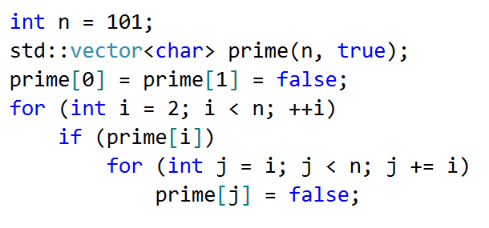
Sieve of Eratosthenes
Code:

Slide 18
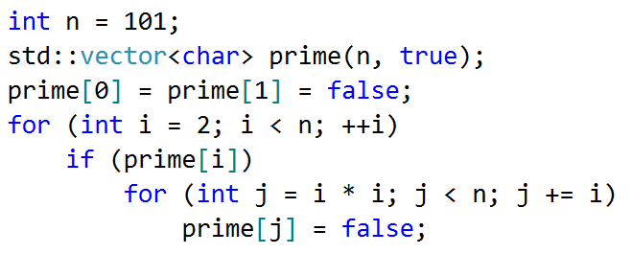

Sieve of Eratosthenes First optimization
All smaller numbers than $i^{2}$ that are multiples of $i$ necessary also have a prime factor which is less than $i$, so all of them were already sifted earlier.
Optimized code:

Slide 19
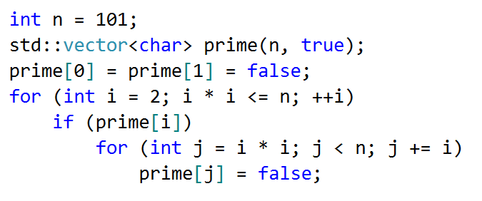
Sieve of Eratosthenes Second optimization
Obviously, to find all the prime numbers until n, it will be enough just to perform the sifting only by the prime numbers, which do not exceed the root of n.
Optimized code:

Slide 20
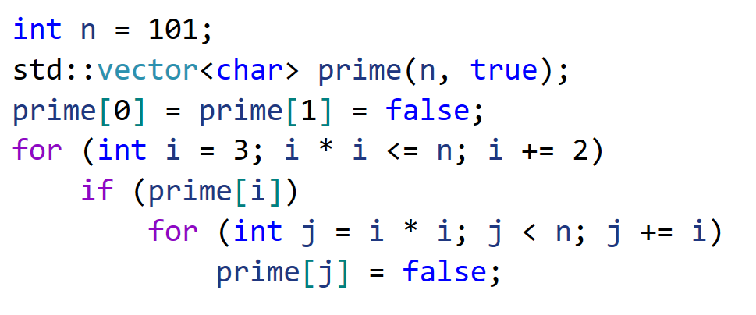
Sieve of Eratosthenes Third optimization
Since all even numbers (except 2) are composite, we can stop checking even numbers at all. Instead, we need to operate with odd numbers only.
It will reduce the number of operations performing by algorithm approximately in half.
Optimized code:

Slide 21
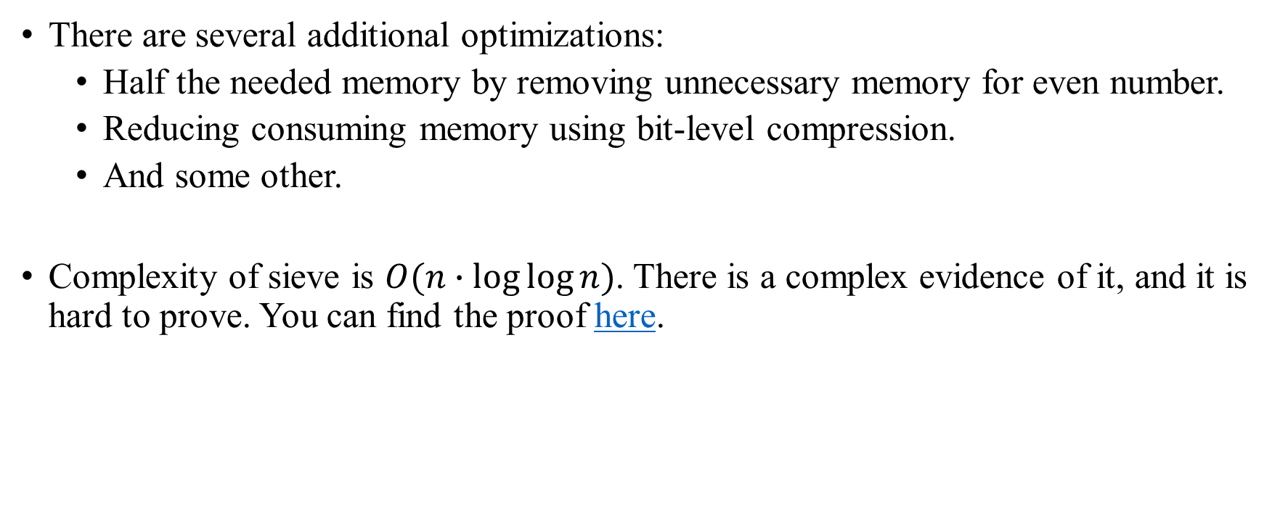
Sieve of Eratosthenes Optimizations and complexity
There are several additional optimizations:
Half the needed memory by removing unnecessary memory for even number.
Reducing consuming memory using bit-level compression.
And some other.
Complexity of sieve is $O(n∙\log{\log{n}})$. There is a complex evidence of it, and it is hard to prove. You can find the proof here.

